Slide 1

System Modelling and Intro to UML
Rami Bahsoon
School of Computer Science, University of Birmingham
r.bahsoon@bham.ac.uk

Slide 2
Objectives
To describe system modelling and abstraction
To introduce various models that can be used to describe an object-oriented analysis and design
To show how the Unified Modelling Language (UML) may be used in software systems

Slide 3
Why do we need models?
Why is code itself not a good model?
Software is getting increasingly more complex
Windows XP: ~40 millions lines of code
A single programmer cannot manage this amount of code in its entirety
Code is not easily understandable by developers who did not write it
We need simpler representations for complex systems
Modeling is a mean for dealing with complexity

Slide 4
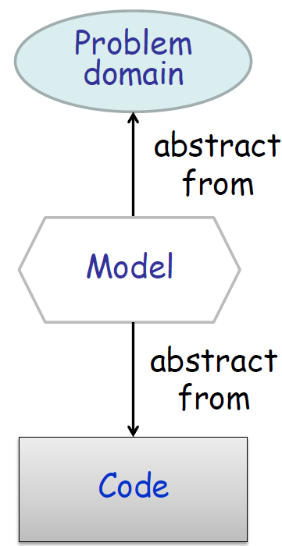
Why do we need models?
Models are abstractions of “the real thing“
They hide complexity by looking at a problem from a certain perspective.
Focus on relevant parts
Ignoring irrelevant details
What is relevant depends on the model
Example: to model the main components of a car, we do not need internal details of the engine.

Slide 5

Abstraction
Highlights common properties of objects
Distinguishes important and unimportant properties
Must be understood even without a concrete object
Concrete Object
General Principle

Slide 6
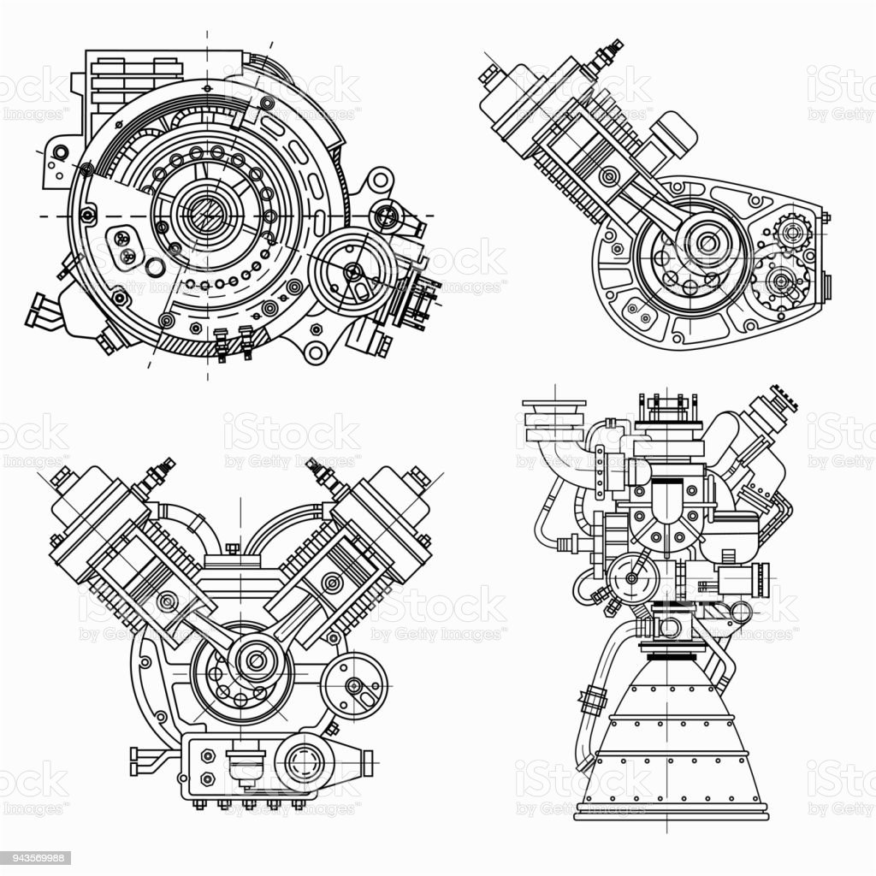
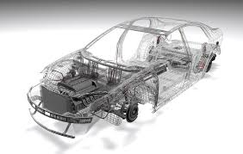
System modeling
System modeling is the process of developing abstract models of a system, with each model presenting a different view or perspective of that system.
Representations of the system to-be-built or as-built
A complete or partial description of a system from a particular perspective: vehicles for communication with various stakeholders
Often captures both structural and behavioural (e.g., interaction) information
System modelling helps the analyst to understand the functionality, boundary (i.e scope – what is internal or external) of the system and interaction between various components

Slide 7
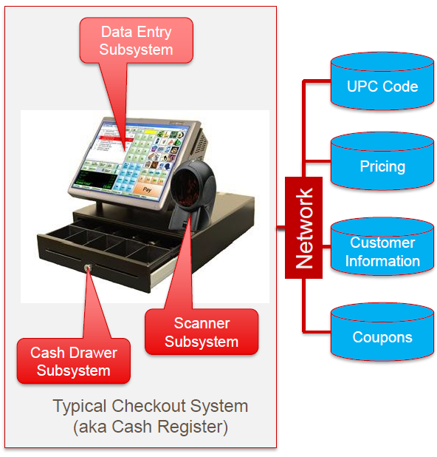
What do we model? - Different views
External The system context or environment
Interaction How the system interacts with its environment, users, or components
Structural (static features) The system’s organization or data
Behavioral (dynamic sequence of flow) The system’s dynamic behaviour and how it responds to events, constraints

Slide 8
System Boundary
System boundaries are established to define what is inside and what is outside the system.
They show other systems that are used or depend on the system being developed.
The position of the system boundary has a profound effect on the system requirements.
Defining a system boundary is a political judgment
There may be pressures to develop system boundaries that increase / decrease the influence or workload of different parts of an organization.
Notes:
From Sommerville Chapter 5

Slide 9
The Interaction Perspective
Modeling user interaction is important as it helps to identify user requirements.
Modeling system-to-system interaction highlights the communication problems that may arise. (external)
Modeling component interaction helps us understand if a proposed system structure is likely to deliver the required system performance and dependability. (internal)

Slide 10
Who and when models are used?
Models are used during requirements engineering:
Elicit, verify, specify, elaborate and refine requirements
Models are used during architecture and design stages:
Architect and Design structure, behavior, interactions etc.
Models can be used by developers: model-driven engineering process, it is possible to generate a complete or partial system implementation from the system model.
Models can be used for testing: generate test cases, verification, model checking etc
Models can be used by managers: planning resources

Slide 11
UML – Unified Modeling Language
Three Amigos
Grady Booch
Unified Modeling Language (UML)
General purpose modeling language (for [OO software] systems)
Today’s de-facto standard in Industry
Some history
In 1997, UML was adopted as a standard by the Object Management Group (OMG).
In 2005, UML was also published by ISO as an approved ISO standard.
Microsoft joined 2008.
Current version is UML 2.5.
James Rumbaugh
Ivar Jacobson

Slide 12
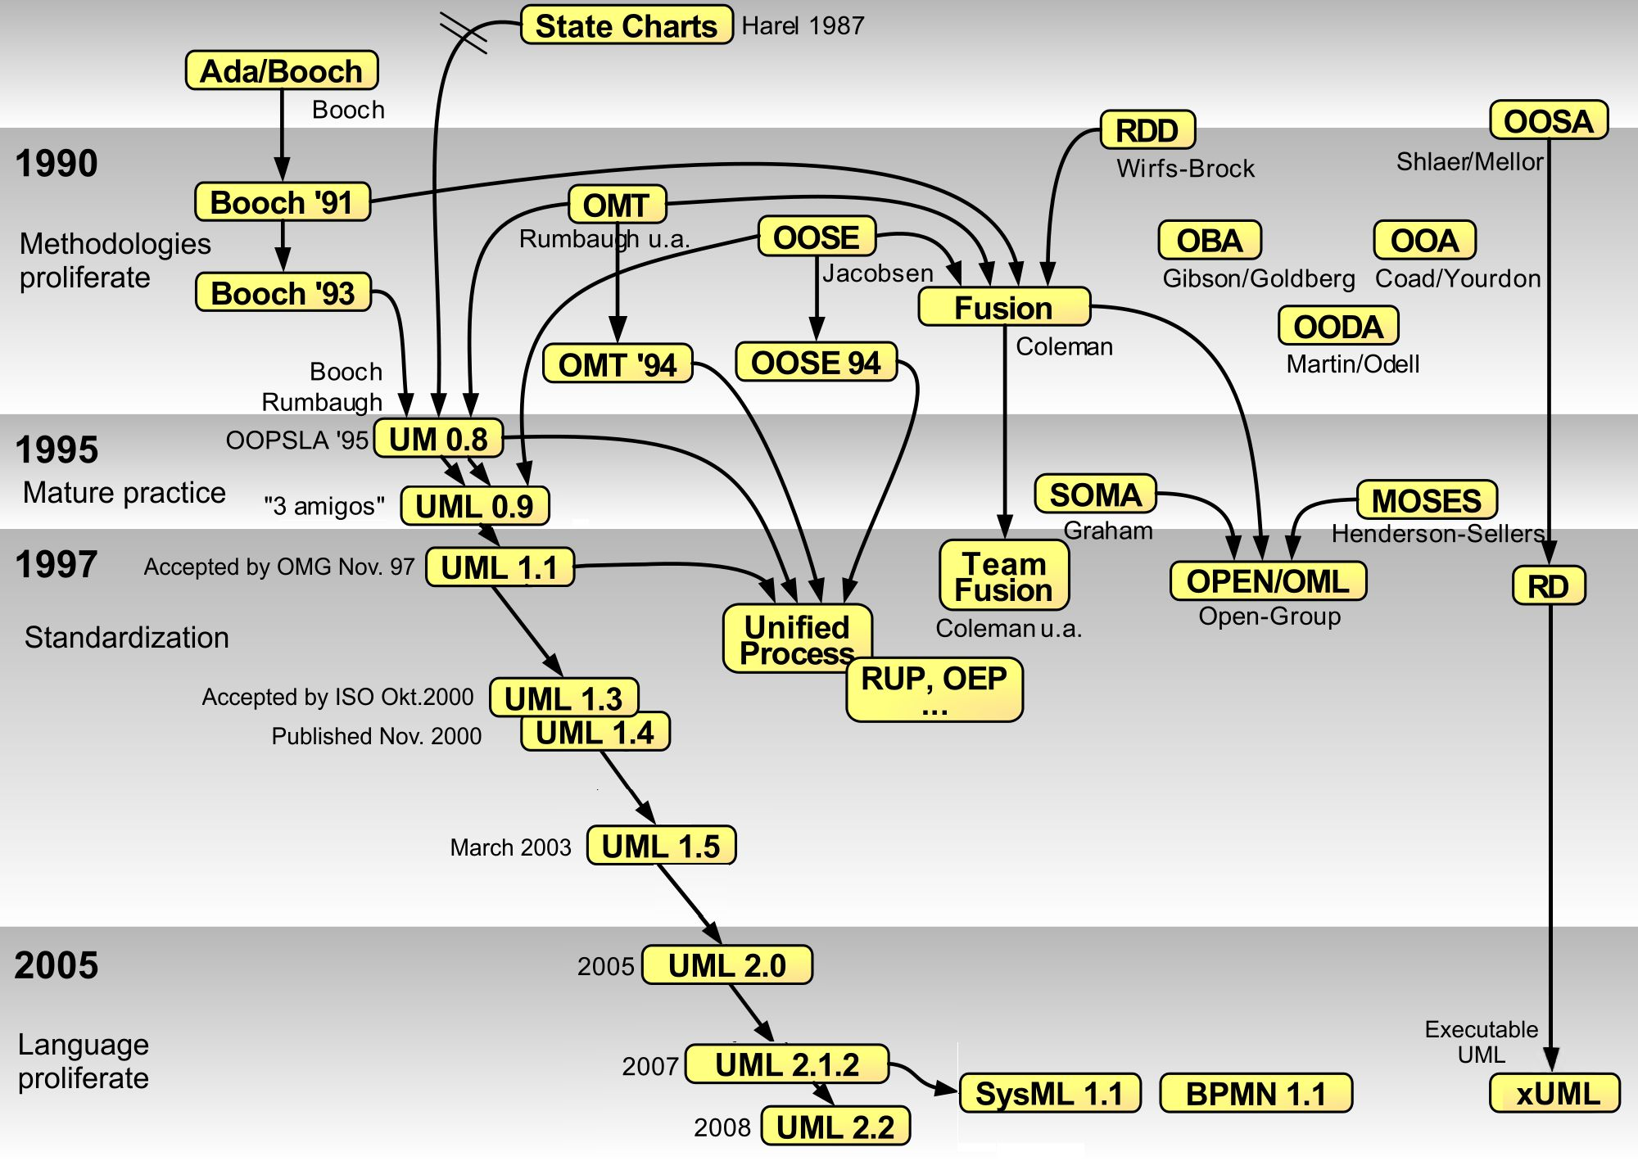
Why “Unified” Modeling Language?
Notes:
From Wikipedia UML page

Slide 13
What is UML?
UML is a standardized language for specifying, visualizing, constructing and documenting (software) systems
Specification: the language is supposed to be simple enough to be understood by the clients, requirements engineers, designers, developers
Visualization: models can be represented graphically
Construction: the language is supposed to be precise enough to make code generation possible and to enable analysis on constructs Model Driven Engineering and Generative
Documentation: the language is supposed to be widely used and understandable by other developers

Slide 14
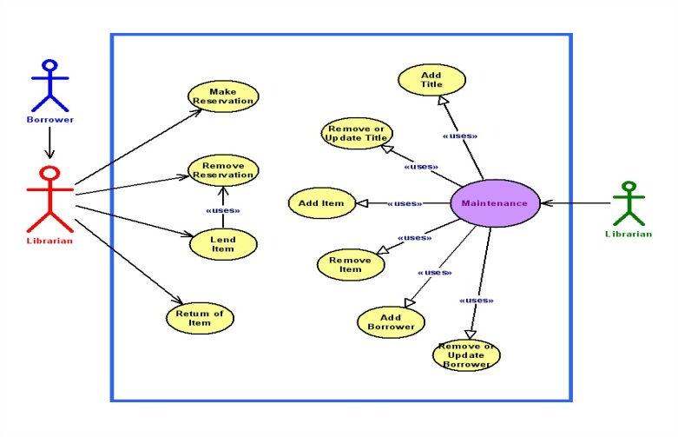
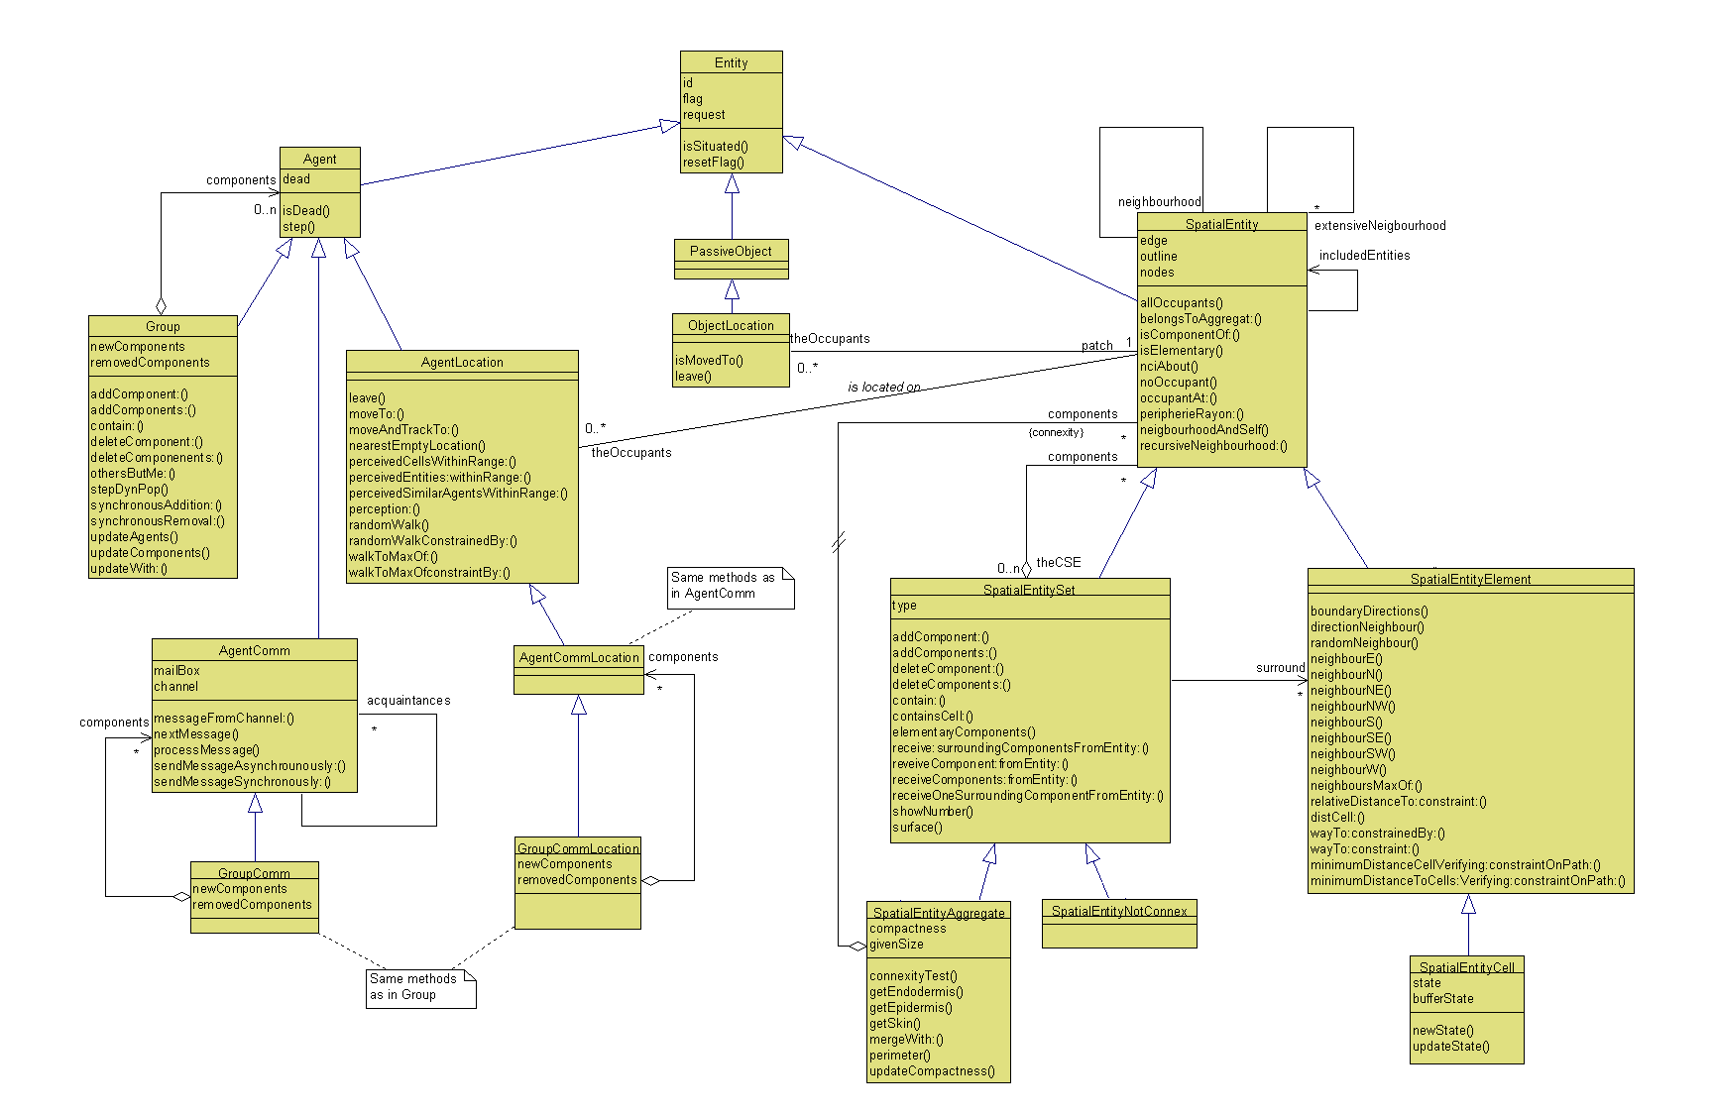
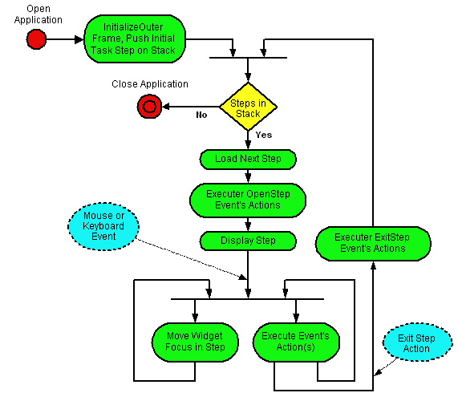
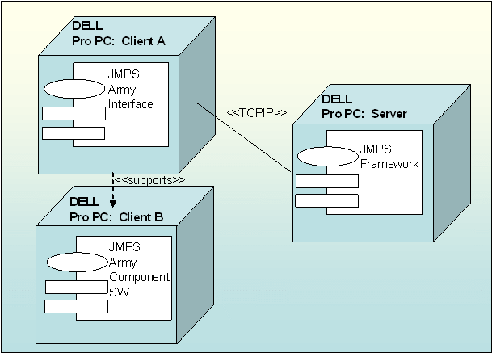
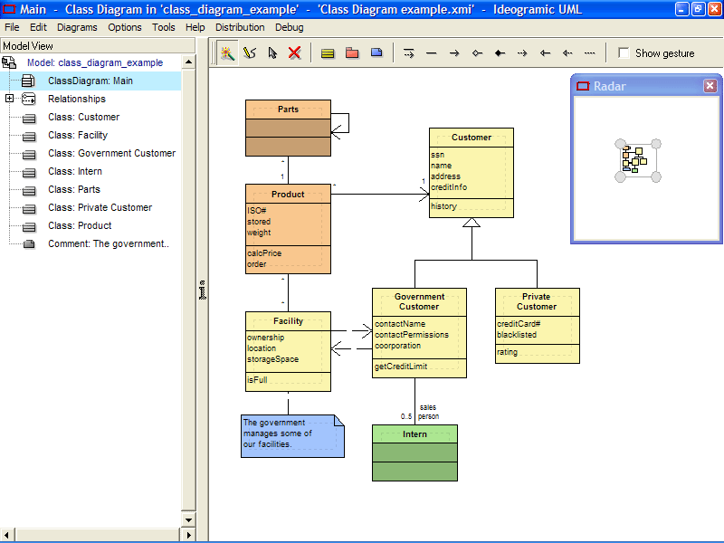
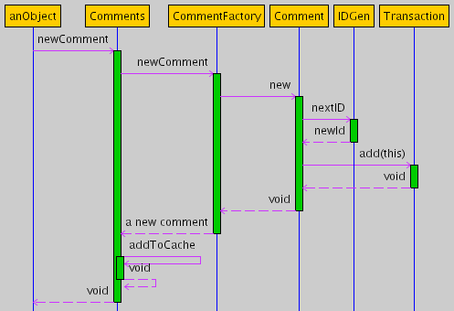
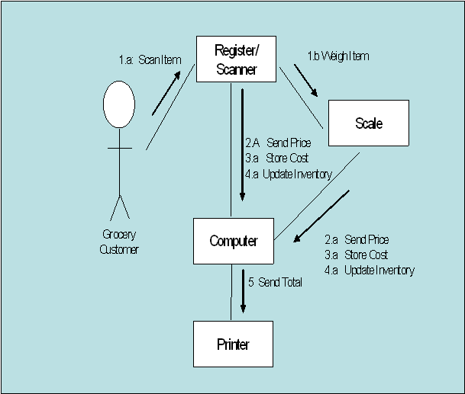

Example: Unified Modelling Language(UML)
Use cases
Class diagram
activity
Deployment
Sequence

Slide 15
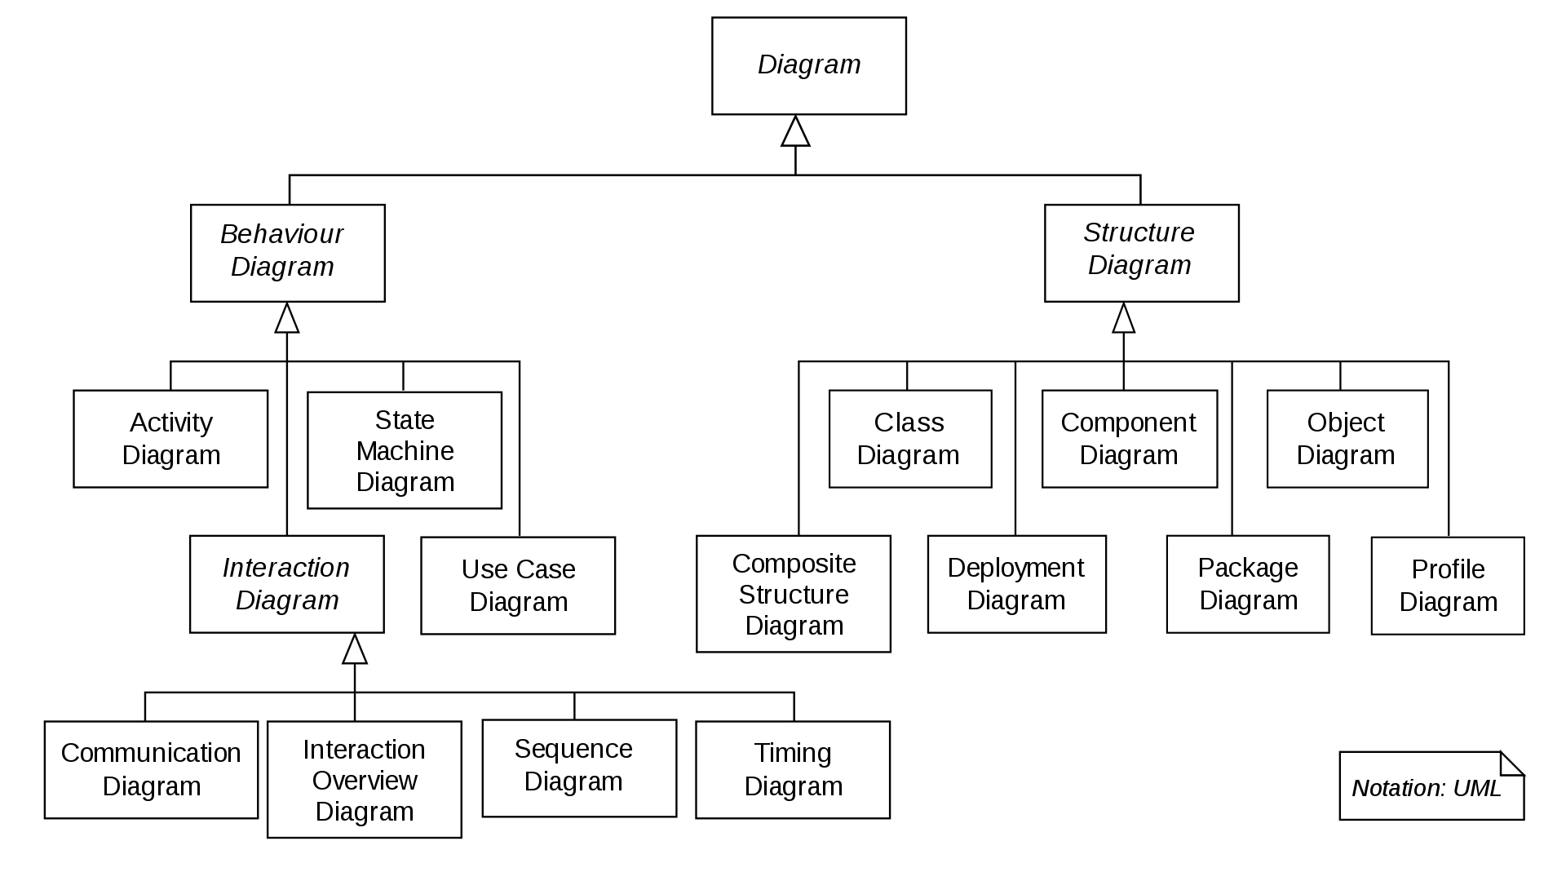
What does UML include?
UML 2.X
Use What You Need. You Probably Don’t Need Everything.
Collaboration Diagram

Slide 16
Summary
A model is an abstract view of a system that ignores system details.
System models can be developed to show the system’s environment, interactions, structure and behavior.
For the environment (external):
Context models show how a system is positioned in an environment with other systems and processes.
Process models show how the system is used.
For the interaction:
Interaction models How the system interacts with its environment, users, or components
For structure and behaviour:
Structural models show the organization and architecture of a system.
Behavioral models are used to describe the dynamic behavior of an executing system.

